Slide 1
Digital Thinking and Innovation
Innovation through Analytics

Slide 2
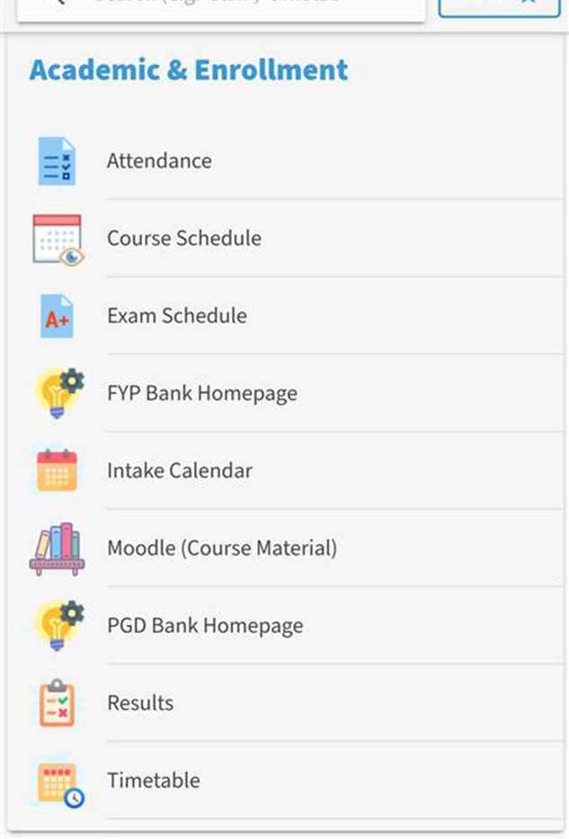
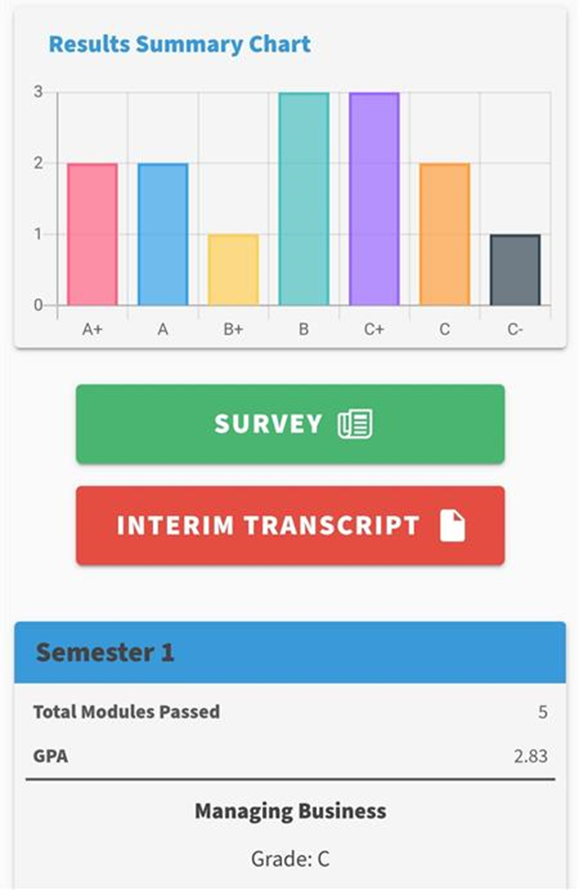
Before we start, let’s fill up the mid semester feedback form
Raise hand in Teams
APSpace > Results > Survey
Fill up mid-sem survey for DGTIN and submit
Remove raised hand in Teams
2
1

Slide 3
Digital Thinking and Innovation
Innovation through Analytics

Slide 4
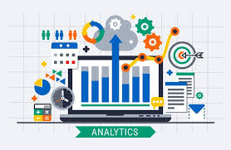
Introduction
This topic discusses the significance of data analytics and how it plays an important role for businesses to make sense of the massive amount of data they collected.

Slide 5
Learning Outcomes for the Lecture
At the end of this lecture you will be able to:
Explain the needs for data analytics
List some of the tools available for data analytics
List some of the required skills for a data analyst
Define Big Data Analytics
Explain the different types of big data analytics
Provide examples on real-life uses of big data analytics

Slide 6
Content
Data Analytics
Needs for Data Analytics
Tools for Data Analytics
Data Analysts and required skills
Big Data Analytics
Types of Big Data Analytics
Real-Life Uses of Big Data Analytics

Slide 7
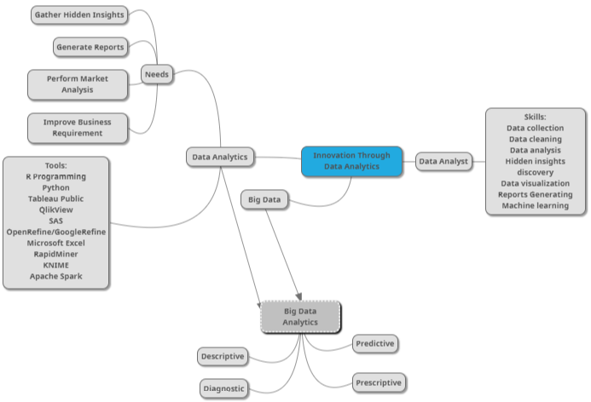
Mind Map

Slide 8
Learning Outcomes for the Lecture
At the end of this lecture you will be able to:
Explain the needs for data analytics
List some of the tools available for data analytics
List some of the required skills for a data analyst
Define Big Data Analytics
Explain the different types of big data analytics
Provide examples on real-life uses of big data analytics

Slide 9
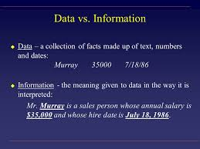
Data vs. Information
Data is raw, unorganized facts that need to be processed
Data can be something simple and seemingly random and useless until it is organized
When data is processed, organized, structured or presented in a given context so as to make it useful, it is called information

Slide 10
Data vs. Information

Slide 11
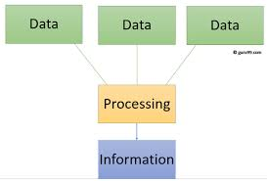
Data vs. Information
a list of dates
Booking system
Departure and arrival

Slide 12
Data Analytics
To benefit from the data collected, every aspect of data needs to be analyzed
The data being generated from large-scale enterprises
The data generated from an individual
Data analytics: The science of analyzing raw data in order to make conclusions about that information, to enhance productivity and business gain.

Slide 13
Data Analytics
Extracted data is cleaned and categorized to analyze different behavioral patterns.
The techniques and the tools used vary according to the organization or individual.
Many of the techniques and processes of data analytics have been automated into mechanical processes and algorithms that work over raw data for human consumption.

Slide 14
Examples Data Analytics
Fraud Management Report which is generally used in Banking Sectors to find the fraud transactions, hacking, unauthorized access to the account and so on.
Live Tracking Report which is generally used by Transport Sectors such as Meru, Ola, Uber, and Mega to track the vehicles, customer’s requests, payment management, emergency alert and to find the daily needs and revenues and so on.
Sales Report and Future target and goal analysis which is mostly used by all sectors to analyze their sales, revenues, and needs of customers and also used to determine the future target and so on.
Google Analytics report where we can get how many user’s visit counts, from which location the user is from, from which device the site is accessing and so on.

Slide 15
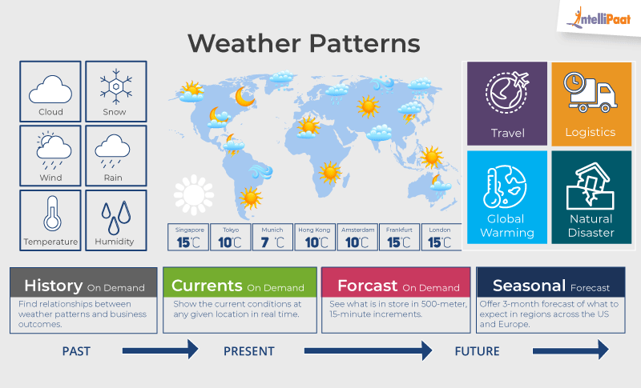
Examples Data Analytics
READ ME

Slide 16
Needs for Data Analytics
Four main factors which signify the need for Data Analytics:
Gather Hidden Insights – Hidden insights from data are gathered and then analyzed with respect to business requirements
Generate Reports – Reports are generated from the data and are passed on to the respective teams and individuals to deal with further actions for a high rise in business

Slide 17
Needs for Data Analytics
Perform Market Analysis – Market Analysis can be performed to understand the strengths and the weaknesses of competitors.
Improve Business Requirement – Analysis of data allows improving business to customer requirements and experience.

Slide 18
Learning Outcomes for the Lecture
At the end of this lecture you will be able to:
Explain the needs for data analytics
List some of the tools available for data analytics
List some of the required skills for a data analyst
Define Big Data Analytics
Explain the different types of big data analytics
Provide examples on real-life uses of big data analytics

Slide 19
Tools in Data Analytics
Many tools have emerged with various functionalities:
R programming – This tool is the leading analytics tool used for statistics and data modeling.
Python –It provides various machine learning and visualization libraries such as Scikit-learn, TensorFlow, Matplotlib, Pandas, Keras etc.
Tableau Public – This is a free software that connects to any data source such as Excel, Corporate Data Warehouse etc. It then creates visualizations, maps, dashboards etc with real-time updates on the web.

Slide 20
Tools in Data Analytics
QlikView – This tool offers in-memory data processing with the results delivered to the end-users quickly. It also offers data association and data visualization with data being compressed to almost 10% of its original size.
SAS – A programming language and environment for data manipulation and analytics, this tool is easily accessible and can analyze data from different sources.
OpenRefine/GoogleRefine – A data cleaning software that will clean up data for analysis. It is used for cleaning messy data, the transformation of data and parsing data from websites.

Slide 21
Tools in Data Analytics
Microsoft Excel – This tool is one of the most widely used tools for data analytics. Mostly used for clients’ internal data, this tool analyzes the tasks that summarize the data with a preview of pivot tables.
RapidMiner – A powerful, integrated platform that can integrate with any data source types such as Access, Excel, Microsoft SQL, Tera data, Oracle, Sybase etc. This tool is mostly used for predictive analytics, such as data mining, text analytics, machine learning.

Slide 22
Tools in Data Analytics
Konstanz Information Miner (KNIME) – Open-source data analytics platform, which allows you to analyze and model data. It provides a platform for reporting and integration through its modular data pipeline concept.
Apache Spark – One of the largest large-scale data processing engine. It executes applications in Hadoop clusters 100 times faster in memory and 10 times faster on disk. Popular for data pipelines and machine learning model development

Slide 23
Learning Outcomes for the Lecture
At the end of this lecture you will be able to:
Explain the needs for data analytics
List some of the tools available for data analytics
List some of the required skills for a data analyst
Define Big Data Analytics
Explain the different types of big data analytics
Provide examples on real-life uses of big data analytics

Slide 24
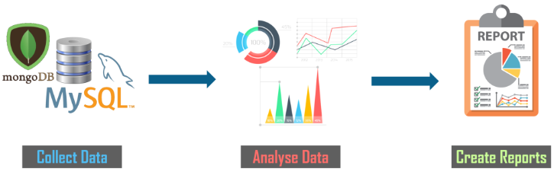
Data Analyst
Data Analyst is a professional who can analyze data by applying various tool and techniques and gathering the required insights
Data analysts translate numbers into plain English

Slide 25
Data Analyst
Skills required:
Statistic
Data collection
Data cleaning
Data analysis
Hidden insights discovery
Data visualization
Reports generating
Machine learning

Slide 26
Learning Outcomes for the Lecture
At the end of this lecture you will be able to:
Explain the needs for data analytics
List some of the tools available for data analytics
List some of the required skills for a data analyst
Define Big Data Analytics
Explain the different types of big data analytics
Provide examples on real-life uses of big data analytics

Slide 27
Big Data Analytics
Big Data: A concept in Software Engineering which we use when we have a large sets of machine generated data, which in most of the cases is unstructured and not easy to use with traditional RDBMS concepts.
Data Analytics: More of analyzing data which could be structured or unstructured.
Big Data Analytics: Complex process of examining large and varied data sets, to uncover information that can help organizations make informed business decisions.

Slide 28
Learning Outcomes for the Lecture
At the end of this lecture you will be able to:
Explain the needs for data analytics
List some of the tools available for data analytics
List some of the required skills for a data analyst
Define Big Data Analytics
Explain the different types of big data analytics
Provide examples on real-life uses of big data analytics

Slide 29
Big Data Analytics
Four types of Big Data Analytics:
Descriptive: Allows organizations to learn from past behaviors, and help them in understanding how they might influence future outcomes: What has happened?
Diagnostic: Often referred to as root cause analysis. It provides deeper analysis to answer the question: Why did this happen?
Notes:
https://www.valamis.com/hub/descriptive-analytics

Slide 30
Big Data Analytics
Four types of Big Data Analytics:
Predictive: Uses this historical data, combined with customer insight, to predict future events. What will happen if…?
Prescriptive: Uses AI to understand what the impact is of future decisions and uses those scenarios to determine the best outcome. What should we do about this?

Slide 31
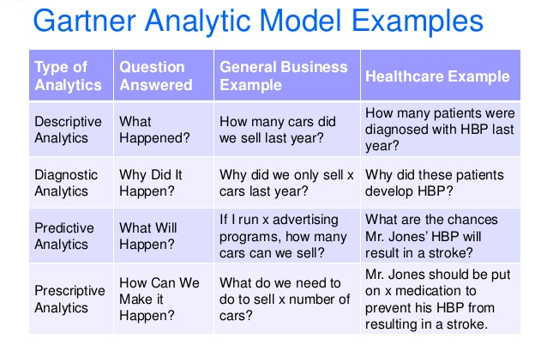
Big Data Analytics

Slide 32

Group Discussion
Watch and discuss the content of the video:
https://www.youtube.com/watch?v=aeHqYLgZP84

Slide 33
Learning Outcomes for the Lecture
At the end of this lecture you will be able to:
Explain the needs for data analytics
List some of the tools available for data analytics
List some of the required skills for a data analyst
Define Big Data Analytics
Explain the different types of big data analytics
Provide examples on real-life uses of big data analytics

Slide 34
Uses of Big Data Analytics
Using Big Data Analytics to Boost Customer Acquisition and Retention
In the year 2015, Coca-Cola managed to strengthen its data strategy by building a digital-led loyalty program.
Coca-Cola director of data strategy was interviewed by ADMA managing editor. The interview made it clear that big data analytics is strongly behind customer retention at Coca-Cola
https://www.adma.com.au/resources/how-coca-cola-uses-data-to-supercharge-its-superbrand-status

Slide 35
Uses of Big Data Analytics
Use of Big Data Analytics to Solve Advertisers Problem and Offer Marketing Insights
Netflix uses big data analytics for targeted advertising
Netflix sends subscriber suggestions of the next movie to watch based the past search and watch data. This data is used to give them insights on what interests the subscriber most.

Slide 36
Uses of Big Data Analytics
Big Data Analytics for Risk Management
UOB bank tested a risk management system that is based on big data.
The big data risk management system enables the bank to reduce the calculation time of the value at risk.
It would initially take about 18 hours
With the risk management system that uses big data, it only takes a few minutes.
Through this initiative, the bank will possibly be able to carry out real-time risk analysis in the near future

Slide 37
Uses of Big Data Analytics
Big Data Analytics As a Driver of Innovations and Product Development
Amazon Fresh and Whole Foods
The data-driven logistics gives Amazon the required expertise to enable creation and achievement of greater value.
Amazon whole foods is able to understand how customers buy groceries and how suppliers interact with the grocer.

Slide 38
Uses of Big Data Analytics
Use of Big Data in Supply Chain Management
PepsiCo relies on huge volumes of data for an efficient supply chain management.
The company is committed to ensuring they replenish the retailers’ shelves with appropriate volumes and types of products.
The company’s clients provide reports that include their warehouse inventory and the POS inventory to the company
This data is used to reconcile and forecast the production and shipment needs.

Slide 39
Summary
Data Analytics/Big Data Analytics
Needs for Data Analytics
Tools for Data Analytics
Types of Big Data Analytics
Real-Life Uses of Big Data Analytics

Slide 40
Questions and Answer
Q & A

Slide 41

Next Lecture
Innovation through IoE

